Slide 1


YaDV Yet another DICOM Viewer Platform to open, view, analyze, classify and enrich DICOM format images.
Presented by
Prahalad Vijaykumar

Slide 2

YaDV – Ideation and Inspiration
Past one year visited hospital frequently for health check and vaccination noticed people running around for scan, xray etc. I was curious how medical equipment's in hospital works and how they interact with other components. This curiosity is the core for this project.
Secondly, I was in the process of learning OpenCV and looked for right opportunity to apply what I have learnt, and this initiative looks like perfect fit.
Is this idea something new? Answer is No. There are different enterprise doing similar work i.e., Siemens, GE Healthcare, Phillips etc. My project is just to break that myth and educate myself and others about how Medical imaging works. That’s the main reason kept title as “Yet another DICOM Viewer”
People talk about Cloud – Super excited to deploy my first app in Heroku Cloud.

Slide 3
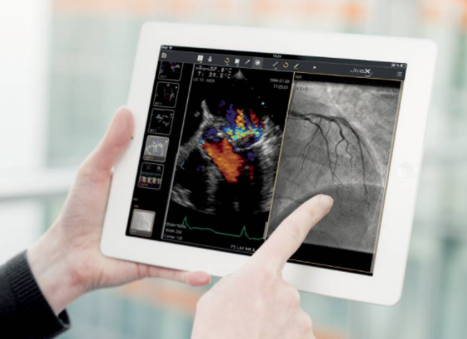
YaDV – Use Cases
YaDV enables medical physicians to open, inspect and save medical images in DICOM format.
Display images from different studies or examinations across modalities i.e. Computed Tomography (CT), Magnetic Resonance etc.
DICOM Image processing
Brightness/contrast control
Zooming and panning DICOM images
Anonymize patient identity during export of DICOM
View 3D/2D images
Image Classification

Slide 4
Problem solved by YaDV
What problem will YaDV solves?
YaDV is an DICOM viewer greatly facilitates the day-to-day of cardiologists, traumatologist, oncologists, etc. and most importantly, it improves the healthcare and service to patients.
YaDV support different image processing abilities and advanced functions. Besides image visualisation YaDV can take measurements and convert images to other formats.
YaDV provides 3D image viewing for the surgical planning
What makes YaDV different: One stop solution for COVID Analysis DICOM format, 3D object view, Image Classification and in future will add hand gesture based DICOM image processing

Slide 5
Content
Radiology Workflow
DICOM Overview
Problem Statement
Architecture
Capabilities
Technologies Used
Next Step

Slide 6
Glossary
Radiology:
Radiology is a branch of medicine that uses imaging technology to diagnose and treat disease
Radiologists:
Radiologist are medical doctors that specialize in diagnosing and treating injuries and diseases using medical imaging (radiology) procedures (exams/tests) such as X-rays, computed tomography (CT), ultrasound etc.
PACS: Picture Archiving and Communication System
PACS is a high-speed, graphical, computer network system for the storage, recovery, and display of radiologic images
HL7: Health Level Seven International
HL7 is a set of international standards used to transfer and share data between various healthcare providers
NEMA: National Electronic Manufacturing Association
An ANSI-accredited Standards Developing Organization. The DICOM Standard is managed by the Medical Imaging & Technology Alliance - a division of the NEMA.

Slide 7
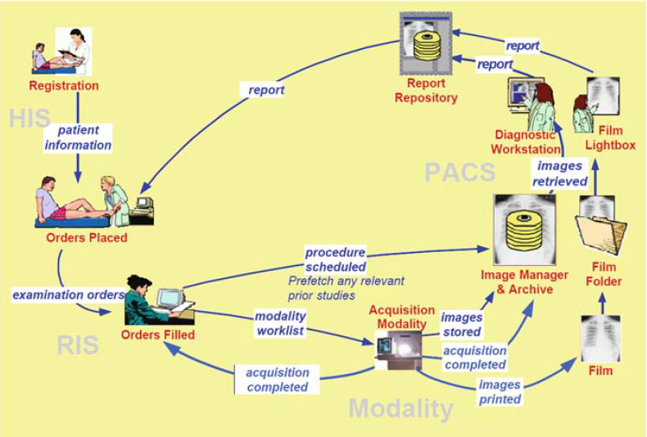
Radiology Workflow
Hospital Information System (HIS) is a comprehensive, integrated information system designed to manage all the aspects of a hospital's operation, such as medical, administrative, financial, and legal issues and the corresponding processing of services.
The Radiology Information System is software that manages the dayto-day operations of a Radiology Department
Patient Information Reconciliation (PIR) coordinates reconciliation of the patient record when images are acquired.

Slide 8
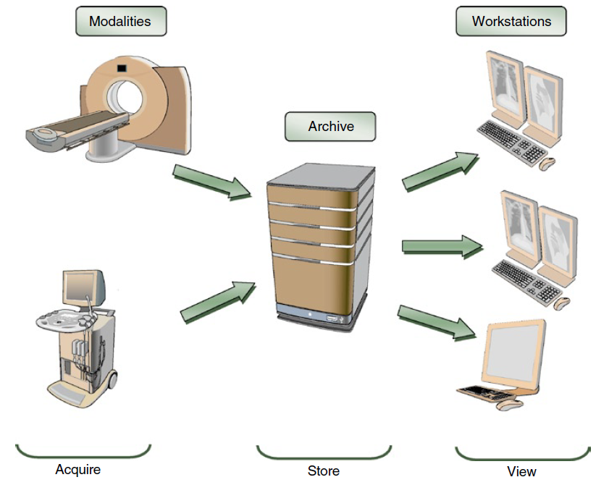
DICOM Overview
DICOM stands for Digital Imaging and COmmunications in Medicine – an universal standard for Digital Imaging.
DICOM is a specification for the creation, transmission, and storage of digital medical image and report data.
Another important acronym that seemingly all DICOM vendors plug into their names is PACS (Picture Archiving and Communication Systems).
PACS are medical systems (consisting of necessary hardware and software) built to run digital medical imaging. They comprise:
Modalities: Digital image acquisition devices, such as CT scanners or ultrasound.
Digital image archives: Where the acquired images are stored.
Workstations: Where radiologists view (“read”) the images. (YaDV)
Notes:
DICOM(Digital Imaging and COmmunications in Medicine) is the de-facto standard that establishes rules that allow medical images(X-Ray, MRI, CT) and associated information to be exchanged between imaging equipment from different vendors, computers, and hospitals.
DICOM files typically have a .dcm extension and provides a means of storing data in separate ‘tags’ such as patient information as well as image/pixel data. A DICOM file consists of a header and image data sets packed into a single file.

Slide 9
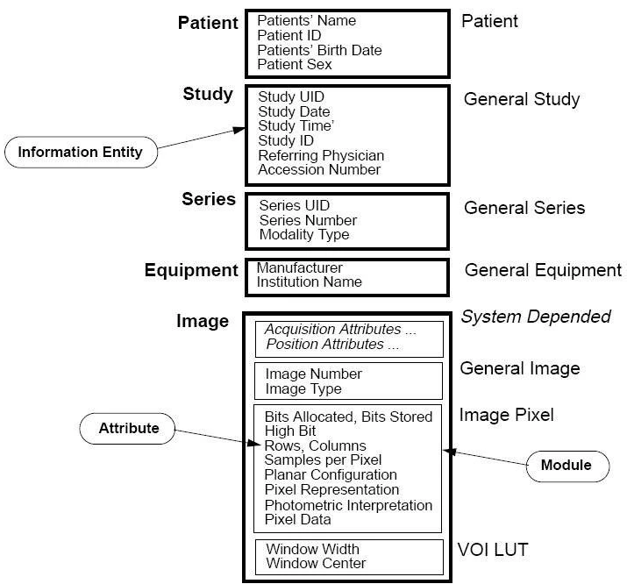
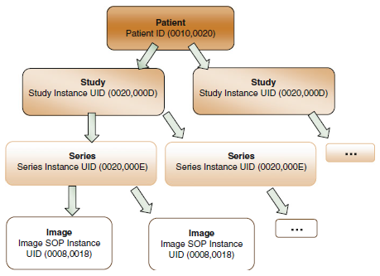
DICOM Structure
TODO

Slide 10
YaDV Overview
YaDV is a web-based DICOM Viewer for PACS enables Radiologist to diagnoses, viewing, and transmitting medical images.
YaDV core capabilities:
Cloud Deployed (Demo purpose deployed in Heroku)
Load and View DICOM Image
View DICOM Head Metadata Information
Basic DICOM Image Operation – i.e. Rotation, Zoom, Measurement etc.
DICOM Image Classification
Export DICOM Image – Anonymize Personal Information

Slide 11
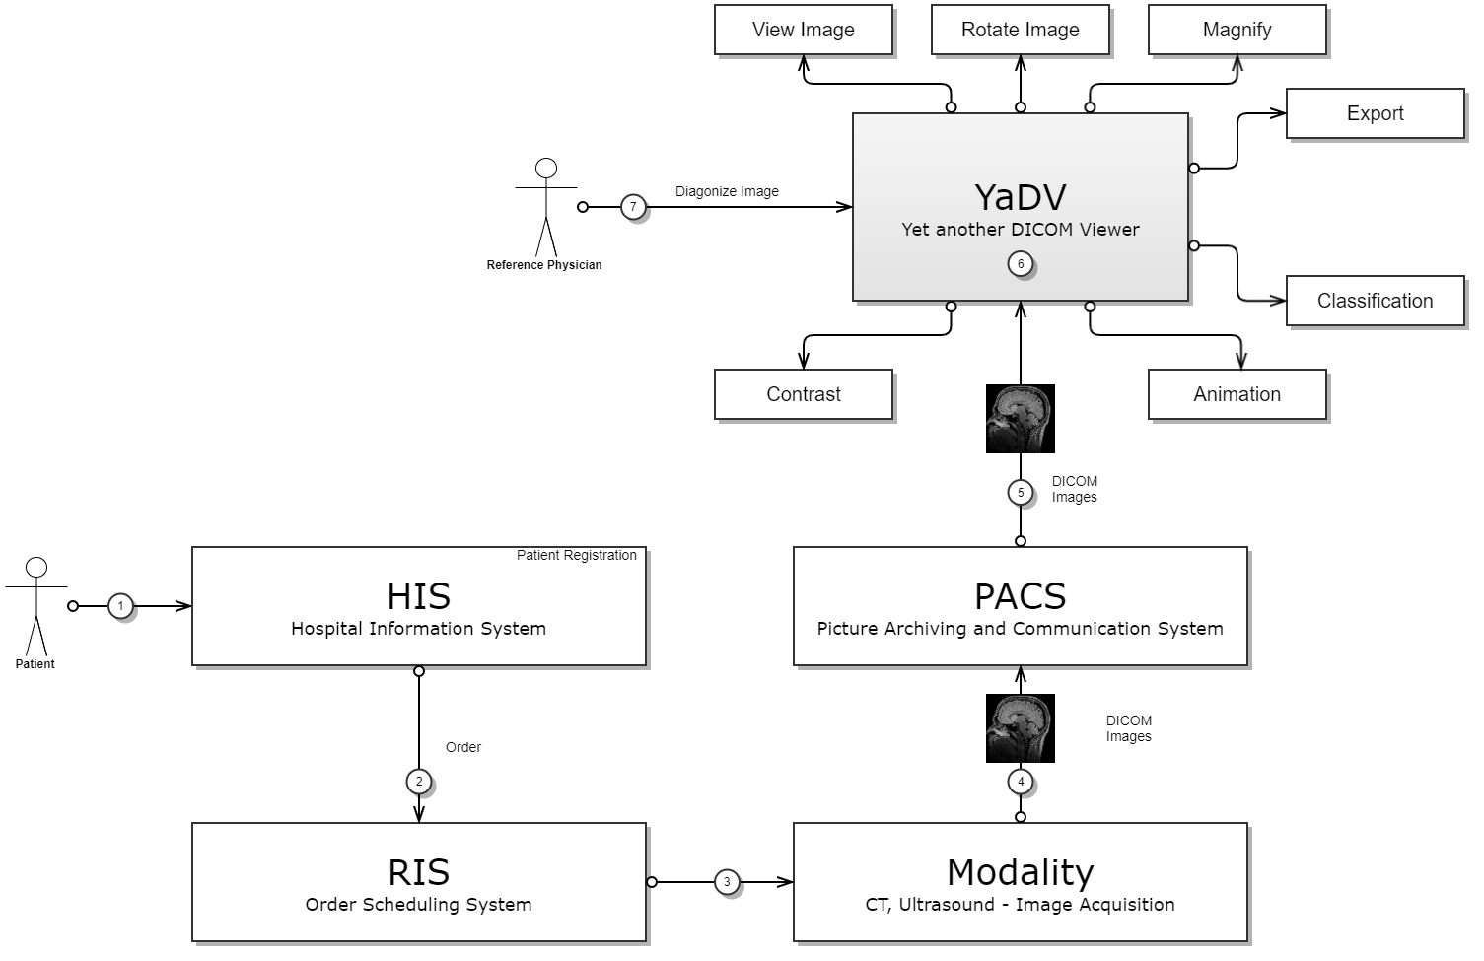
YaDV Architecture

Slide 12
YaDV – Technologies Used
Technology | Technology Overview | Alternative Considered | Reason
OpenCV | OpenCV provides a real-time optimized Computer Vision library, tools, and hardware. | OpenCV and MatPlot | Opted for OpenCV since I am comfortable with this.
PyDICOM | pydicom is a pure Python package for working with DICOM files such as medical images, reports, and radiotherapy objects. | PyDicom | Widely used framework and good documentation.
FastAI | fastai is a deep learning library which provides practitioners with high-level components that can quickly and easily provide state-of-the-art results in standard deep learning domains, and provides researchers with low-level components that can be mixed and matched to build new approaches.
Streamlit | Streamlit is an open-source Python library that makes it easy to create and share beautiful, custom web apps for machine learning and data science. | Streamlit and tkinter | Selected Streamlit because of ease of use. Instant deployment and compatible with other python libraries.
Gliffy | N/A | N/A | For high level flow diagram for this project (30days free trial edition)
Heroku | Heroku is a cloud platform as a service (PaaS) supporting several programming languages | N/A | Ease to deploy from Github

Slide 13
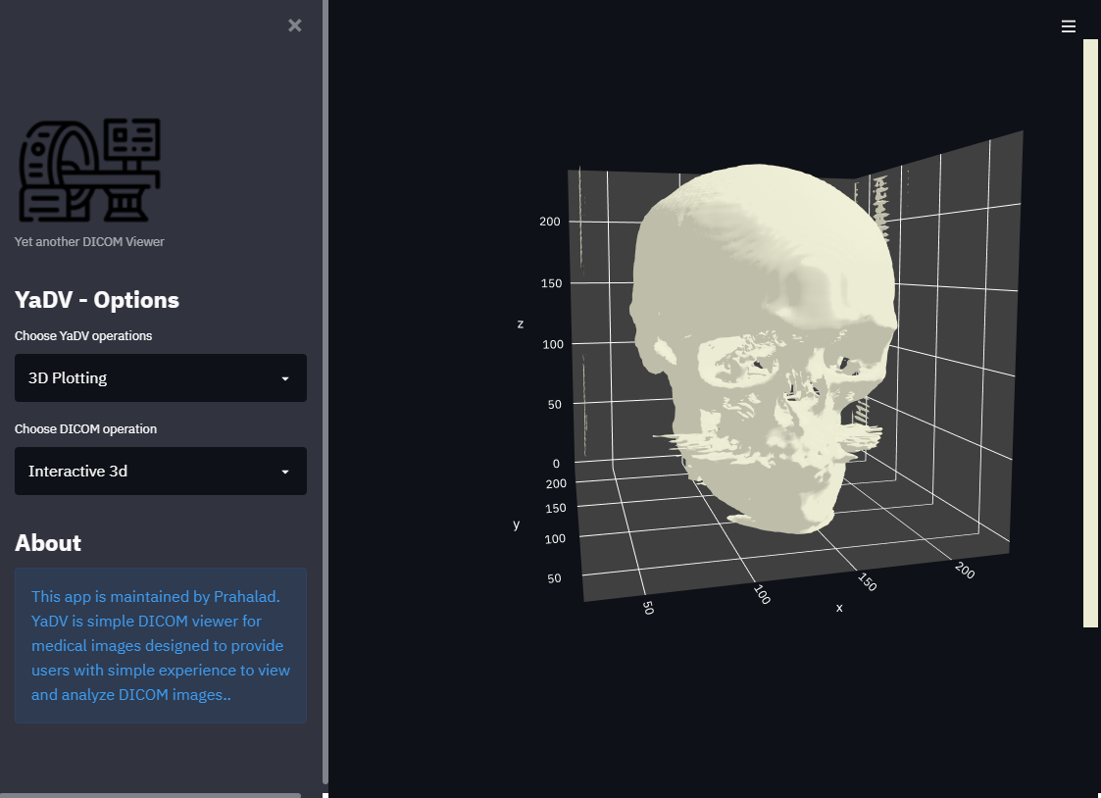

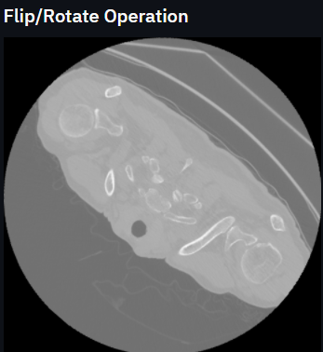
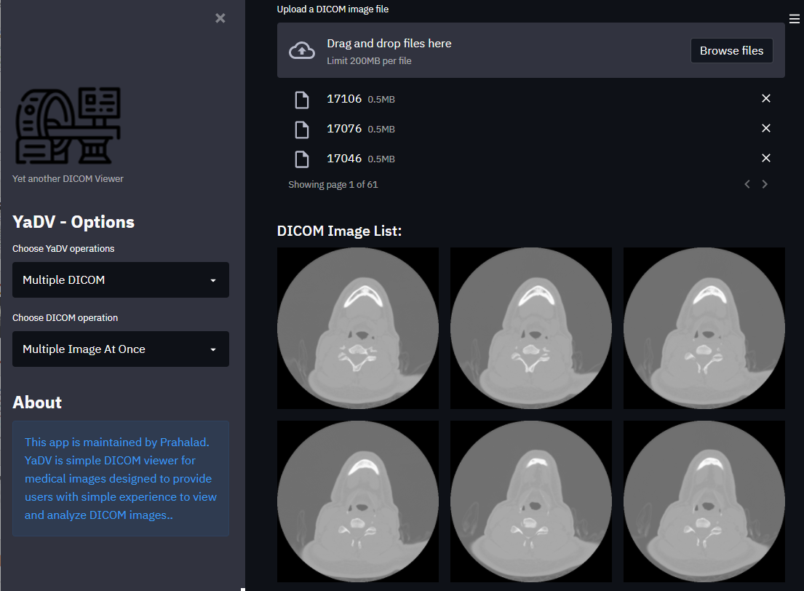
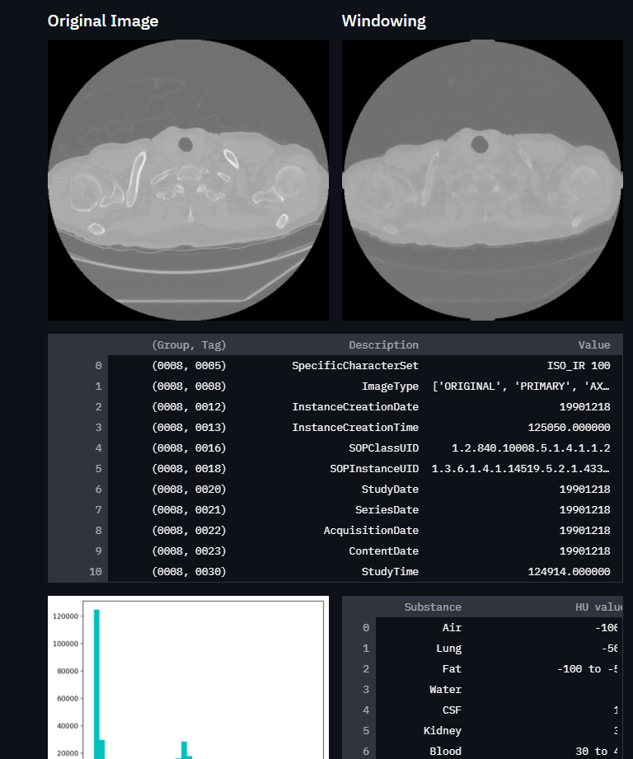
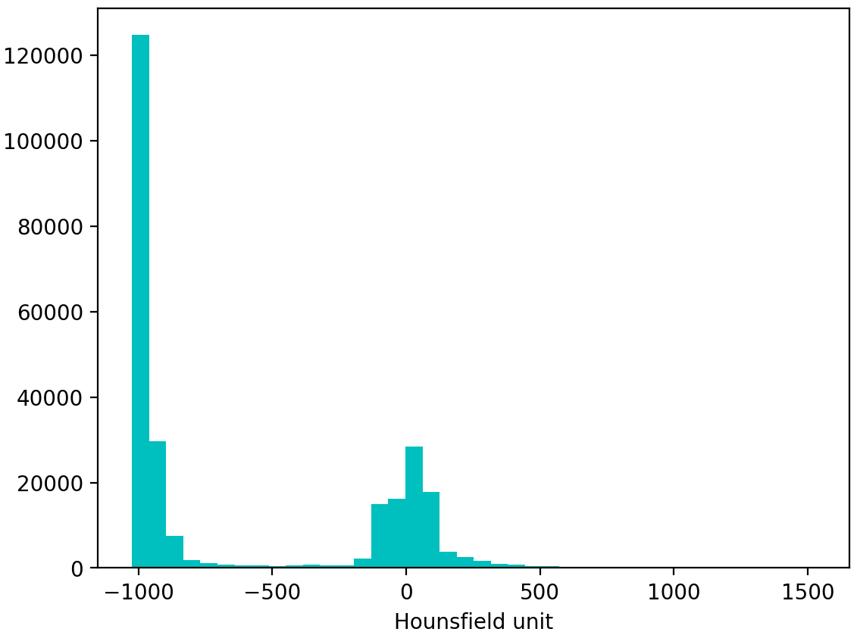
YaDV – User Interface

Slide 14
YaDV – Next Step
Learn more on DICOM TAGs – Refer link
Hand Gesture based Image operation
The Value Of Interest Lookup (VOI LUT - 0028, 3010) Table Implementation
Advance measurement overlay on top of images
More 3D Image support and 3D specific operation
Open multiple image in parallel and compare
Predict COVID cases based on CT Images
Predict COVID cases based on XRays
Integration with PACS
Scan patient, auto face detect and pull patient history from PACS

Slide 15
YaDV – Reference
Topic | Reference Link
Digital Image Communication in Medicine | Book from Oleg S. Pianykh
National Electrical Manufacturers Association (NEMA) | http://dicom.nema.org/medical/dicom/current/output/chtml/part10/chapter_7.html
Python library for DICOM | https://pypi.org/project/pydicom/
FAST.AI for Medical Image Processing | https://docs.fast.ai/medical.imaging
User Interface for Image Viewer | https://streamlit.io/
Heroku Deployment | https://towardsdatascience.com/deploying-a-basic-streamlit-app-to-heroku-be25a527fcb3

Slide 16


